Slide 1
Smarter Balanced & Higher Education
Dianne M. Bazell, Ph.D.
Senior Higher Education Regional Advisor
West Virginia Advisory Council of Faculty
July 28, 2013

Slide 2
Why Define College-Readiness Expectations?
“General” high school track is “Ticket to Nowhere”*
Overall cost of remediation in the US estimated at over $3.7 billion annually
Cost of “double teaching” at community colleges plus reduced potential income of college dropouts (WV ― $3.8m)*
Student pipeline transition and completion rates* from ninth grade to college (150% of program time):
US average: 20.5 percent
West Virginia: 16.6
*Sources: Haycock (1999); Alliance for Excellent Education, “Paying Double: Inadequate High Schools and Community College Remediation” (August, 2006); NCHEMS Information Center data (2008): http://www.higheredinfo.org/dbrowser/index.php?submeasure=119&year=2008&level=nation&mode=graph&state=0
Notes:
Personal cost
Economic: at multiple levels Taxpayers’ cost
WHY DEFINE COLLEGE READINESS EXPECTATIONS?
Pipeline rates: NCHEMS Information Center data (2008): http://www.higheredinfo.org/dbrowser/index.php?submeasure=119&year=2008&level=nation&mode=graph&state=0
Grad rates: NCHEMS Information Center data (2009): http://www.higheredinfo.org/dbrowser/index.php?submeasure=36&year=2009&level=nation&mode=graph&state=0
% of ACT-tested HS grads meeting/exceeding college readiness benchmark scores:
English: US 66%; WV 70%
Math: US 45%; WV 32 %
US: http://www.act.org/research/policymakers/cccr11/readiness1.html
WV: http://www.act.org/newsroom/data/2011/pdf/profile/WestVirginia.pdf

Slide 3
Common Core State Standards (CCSS)
Preceded by American Diploma Project (piloted 2001-2003)
Initiated by National Governors Association and Council on Chief State School Officers initiative (2009-2010)
Provide benchmarks for all students in English language arts and mathematics
Require new assessment system
Notes:
D.C., Guam, American Samoa Islands, U.S. Virgin Islands
ELA strands: reading, writing, speaking and listening, research
Math strands: concepts and procedures, problem solving, communicating reasoning, modeling and data analysis
--Make sense of problems and persevere in solving them; reason abstractly and quantitatively; construct viable arguments and critique the reasoning of others; model with mathematics; use appropriate tools strategically; attend to precision; look for and make use of structure; look for and express regularity in repeated reasoning.
--Number and quantity; algebra; functions; modeling; geometry; statistics and probability.
COMMON CORE STATE STANDARDS
Not AK, MN (only Eng), NB, TX, VA, PR, Amer Samoa, N. Mariana Islands /
Yes—D.C., V.I., Guam, plus Dept of Defense Education Activity
ELA: reading, writing, speaking, listening, language
Math:
--Make sense of problems and persevere in solving them; reason abstractly and quantitatively; construct viable arguments and critique the reasoning of others; model with mathematics; use appropriate tools strategically; attend to precision; look for and make use of structure; look for and express regularity in repeated reasoning.
--Number and quantity; algebra; functions; modeling; geometry; statistics and probability.

Slide 4
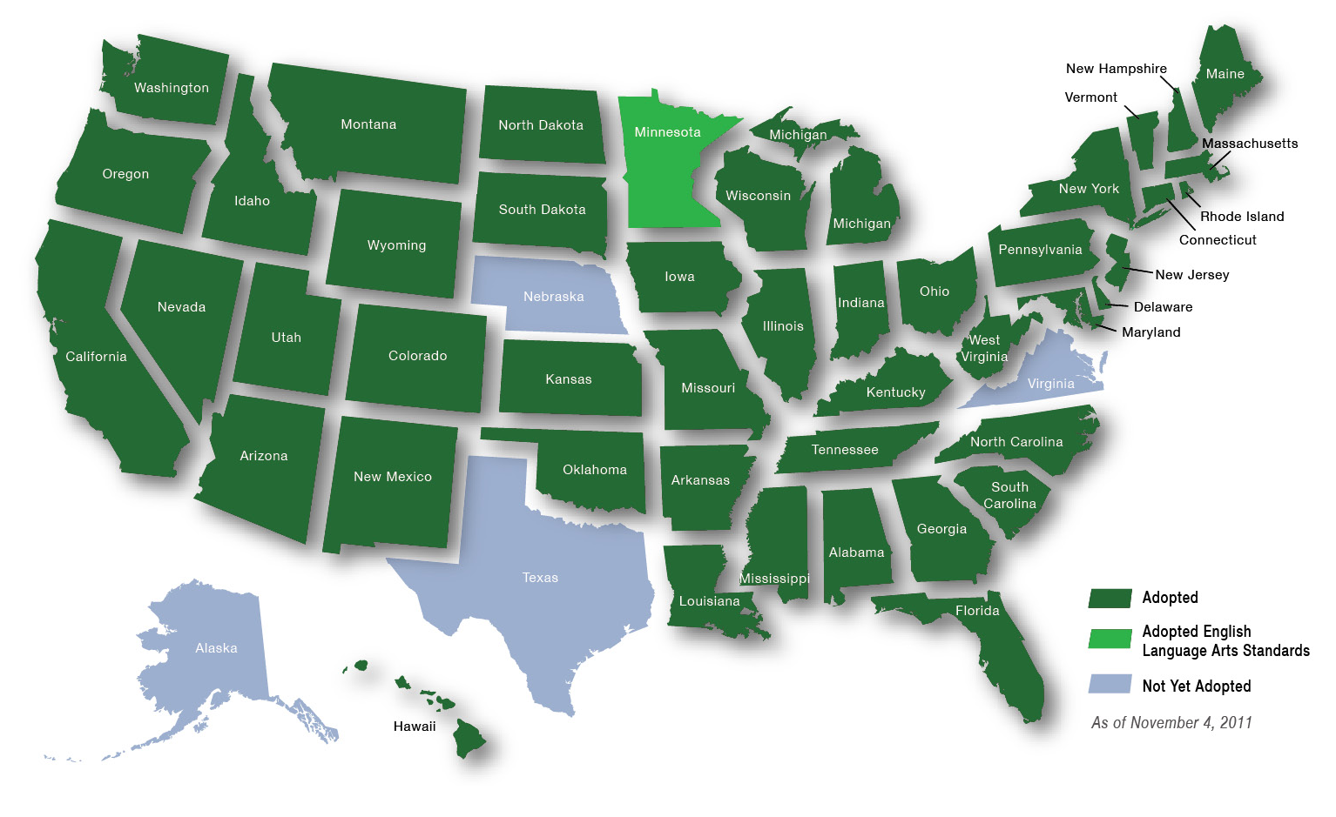
Common Core State Standards
Define knowledge and skills students need for college and skilled employment
Provide clear, consistent standards in English language arts/literacy and mathematics
Were developed by states with input from K-12 teacher and college faculty – adopted by 45 states and 3 territories
Source: www.corestandards.org
Notes:
D.C., Guam, American Samoa Islands, U.S. Virgin Islands
ELA strands: reading, writing, speaking and listening, research
Math strands: concepts and procedures, problem solving, communicating reasoning, modeling, and data analysis
--Make sense of problems and persevere in solving them; reason abstractly and quantitatively; construct viable arguments and critique the reasoning of others; model with mathematics; use appropriate tools strategically; attend to precision; look for and make use of structure; look for and express regularity in repeated reasoning.
--Number and quantity; algebra; functions; modeling; geometry; statistics and probability.
COMMON CORE STATE STANDARDS
Not AK, MN (only Eng), NB, TX, VA, PR, Amer Samoa, N. Mariana Islands /
Yes—D.C., V.I., Guam, plus Dept of Defense Education Activity

Slide 5
What Common Core Assessments Can Provide
Vertical alignment of K-12 and postsecondary systems
A single set of clear expectations for students, teachers, and schools
Systematic tracking of performance for schools, parents, and students
Benefit of an early warning system for students and better use of senior year
Reduced postsecondary remediation and increased college success
Notes:
Emphasis on FOCUS (in mathematics, fewer topics, in greater depth), COHERENCE (linking to focal standards within grades and across grade groups), and RIGOR (in math: conceptual understanding, procedural skill and fluency, application of skills to problem-solving situations
In ELA, Text complexity, close reading, use of primary texts in reading, greater emphasis on narrative, information writing, argument, speech—at all grades—evidenced-based writing

Slide 6
Cross-state Assessment Initiative
Two national consortia
Funded by US Department of Education
Next generation of assessments – grades 3-8 and 11
Geared to bridge the gap between K-12 and postsecondary sectors
Involve K-12 and postsecondary educators, researchers, and policymakers
Operational in 2014-15 school year
Notes:
SMARTER Balanced Assessment Initiative “Summative Multi-state Assessment Resources for Teachers and Educational Researchers”
—managed by CCSSO and WestEd
PARCC = “Partnership for Assessment of Readiness for College and Careers”—
managed by Achieve
Both spearheaded by NGA

Slide 7
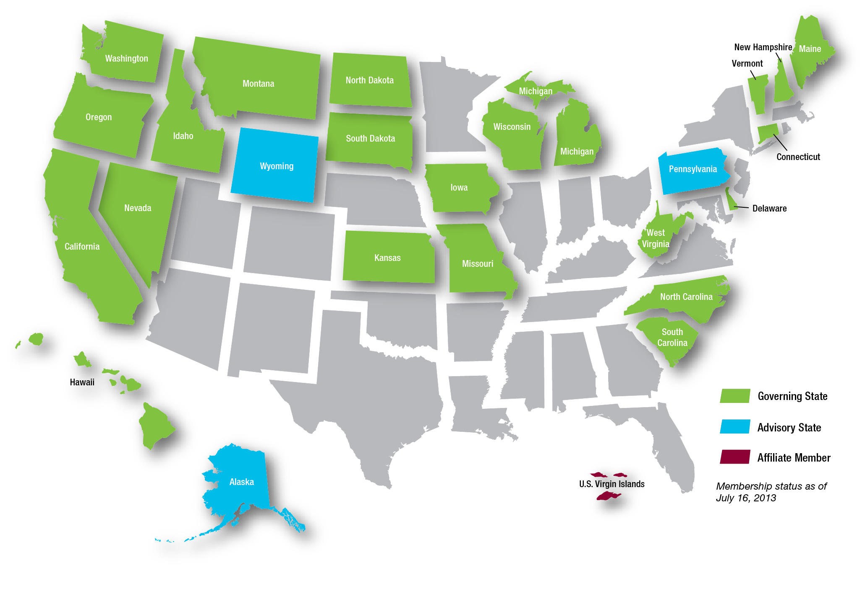
Smarter Balanced Assessment Consortium
26 states & territories (22 governing, 3 advisory, 1 affiliate)
K-12 & Higher Education Leads in each state
Notes:
26 states & territories (22 governing, 3 advisory, 1 affiliate)
K-12 and higher education leads in each state
Purpose of SB Consortium:
1)To develop a comprehensive and innovative assessment system* for grades 3-8 and high school in English language arts and mathematics aligned to the Common Core State Standards, so that . . .
2) . . . students leave high school prepared for postsecondary success in college or a career through increased student learning and improved teaching.
To be operational across Consortium states in the 2014-15 school year
PARCC = “Partnership for Assessment of Readiness for College and Careers”

Slide 8
Smarter Balanced Assessments
Online administration, with timely results
Computer-adaptive technology
Variety of question types: selected response, short constructed response, extended constructed response, technology enhanced, and performance
Formative, interim, and summative assessments, for more responsive teaching and better advising
Impact on teaching and learning
Common, comparable scores across member states and across consortia
Source: Federal Register / Vol. 75, No. 68 / Friday, April 9, 2010, pp. 18,171-85

Slide 9
A Balanced Assessment System
Summative assessments
Benchmarked to college and career readiness
Teachers and schools have information and tools they need to improve teaching and learning
Common Core State Standards specify
K-12 expectations for college and career readiness
All students leave high school college and career ready
Teacher resources for
formative assessment practices
to improve instruction
Interim assessments Flexible, open, used for actionable feedback

Slide 10
Reaching the Goal with Higher Education Partnership
What IS Asked of Higher Education
What is NOT Asked of Higher Education
Lead role in standard-setting for 11th-grade assessment
Agreement on performance standards for placement in the most common credit-bearing entry-level courses:
College Algebra
Freshman Composition
Participation in assessment design
Use of Smarter Balanced assessment for admission
Standardization of postsecondary admissions standards
Complete reliance on the Smarter Balanced assessment for placement decisions

Slide 11
Benefits to Higher Education
Better-prepared entering students, who know what is required of them
Less need for remediation
Better use of effort, time, and resources
Improved postsecondary persistence and completion

Slide 12
Implications for Arts & Sciences: What Will 11th-, 12th-, and 13th Grades Look Like?
NEW CURRICULAR MATERIALS for 12th-grade transitional courses
“Remedial” catch-up courses in 12th grade, before college
“Maintenance” courses for students on-track for college
“Pre-calculus” or other courses for students aspiring to STEM-based programs
OTHER HIGH SCHOOL INTERVENTIONS
Early college
Dual credit courses
ALIGNING CURRICULA
-- General education entrance
-- Developmental exit
-- “Blended” developmental courses
_ Transfer standards
CLARITY FOR ADULT EDUCATION
Notes:
“Summative Multi-state Assessment Resources for Teachers and Educational Researchers”

Slide 13
Implications for Teacher Education
Greater emphasis on CONTENT KNOWLEDGE
— Close reading of texts and expository writing across the curriculum
— Quantitative reasoning across the curriculum
METHODS courses geared to shift in instructional emphasis:
Broader array of pedagogy to elicit deeper understanding
Resource analysis, so teachers can evaluate resources and improve them
ASSESSMENT LITERACY, i.e. how to use (and not use) test results:
Formative assessments (not summative): how to individualize day-to-day instruction
Interim assessments: how to take periodic pulse, modify lesson plans, curriculum
Summative assessments: how to assess individual growth over time and readiness for college; be accountable at school, district, even classroom level; make curricular changes; for educational leaders, how to reallocate resources
CURRICULAR REVISION
—12th-grade transition courses
Notes:
“Summative Multi-state Assessment Resources for Teachers and Educational Researchers”

Slide 14
Challenges for Higher Education
Attitudes/Views: “College isn’t for everyone” / “College isn’t professional or skilled ‘training’” / “K-12 can’t be trusted”/ “This too shall pass”
Structural issues:
K-12 and higher education are separate systems, separately funded, separately governed
Not part of faculty reward system—additional responsibility for those already overworked and underpaid
Institutional and faculty governance
Lowering of standards?
Intrusion into faculty prerogative
Too “one-size-fits-all” for intellectual or pedagogical good

Slide 15
Smarter Balanced Goals for Higher Education
Colleges and universities recognize the Smarter Balanced grade 11 assessment as a valid measure of college content-readiness as defined by the Common Core State Standards.
Colleges and universities agree on common performance standards in English language arts/literacy and mathematics for exemption from remediation (in combination with state-set standards for grade 12).
Colleges and universities use the Smarter Balanced assessment as evidence that students are ready for credit-bearing course work and can be exempted from developmental courses.

Slide 16
What is Content Readiness?
English Language Arts/Literacy | Students who perform at the College Content-Ready level in English language arts/literacy demonstrate reading, writing, listening, and research skills necessary for introductory courses in a variety of disciplines. They also demonstrate subject-area knowledge and skills associated with readiness for entry-level, transferable, credit-bearing English and composition courses.
Mathematics | Students who perform at the College Content-Ready level in mathematics demonstrate foundational mathematical knowledge and quantitative reasoning skills necessary for introductory courses in a variety of disciplines. They also demonstrate subject-area knowledge and skills associated with readiness for entry-level, transferable, credit-bearing mathematics and statistics courses.

Slide 17
Policy Framework for Grade 11 Assessment Results
Level 1
Not Yet Content-Ready - Substantial Support Needed
K-12 & higher education may offer interventions
Level 2
Not Yet Content-Ready – Support Needed
Transition courses or other supports for Grade 12, retesting option
Level 3
Conditionally Content-Ready/Exempt from Developmental
In each state, K-12 and higher ed jointly develop Grade 12 requirements to earn exemption
Level 4
Content-Ready/Exempt from Developmental
In each state, K-12 and higher education may jointly set Grade 12 requirements to retain exemption
Note: Applies only to students who matriculate directly from high school to college.
Notes:
These are the Policy ALDs based on the overall claim for grade 11. The policy ALDs for Grades 3-8 are similar
--Thorough, Adequate, Partial, Minimal

Slide 18
Student Scenario Examples [To be determined by states]
Maria earns Level 4 on the math assessment. She wants to take Calculus in college so she will take pre-calculus as a senior and may take a placement test when she arrives at college.
Jason earns Level 3 on the math assessment. To be exempt from developmental courses, he has to take Statistics or Trigonometry in Grade 12 and earn a grade of B or better.
Kathy earns Level 2 on the math assessment. Her high school offers her an intensive math course with the local community college. Near the end of Grade 12, she will either retake the Smarter Balanced exam or a take a college placement test.

Slide 19
Next Steps
Development of Communications Resources | Spring 2013
Integration with Reporting System (task force) | Summer – Fall 2013
States Determine Grade 12 Requirements | 2013-14 Academic Year
Comparability with PARCC | Spring – Fall 2013
Career Readiness Policy (task force)* | Spring 2013- Winter 2014
Validation Research Planning | Spring- Fall2013
Validation Research Implementation | Spring 2014 - 2017
Standard-setting* | Summer 2014
Development of Reporting ALDs * | Spring-Summer 2014
Institutional participation decisions | Beginning Fall 2014
* Subject to state vote by K12 and higher education.
Notes:
Working with UCLA/CRESST (National Center for Research on Evaluation, Standards, & Student Testing) to serve as host and partner for a sustainable Smarter Balanced
Key principles:
Retain state led governance of the Consortium (only minor changes to governance structure envisioned)
Shared state ownership of the item pool, digital library, and other IP
Smarter Balanced will perform services necessary to maintain quality and comparability of the assessment system; states and their vendors will manage test administration

Slide 20
Some Additional Resources
Common Core State Standards: http://www.corestandards.org/
Reaching the Goal: The Applicability and Importance of the Common Core State Standards to College and Career Readiness, by D.T. Conley, K.V. Drummond, A. de Gonzalez, J. Rooseboom, & O. Stout: http://knowledgecenter.completionbydesign.org/resource/355
Sample Items accessed online through a simulated test platform: http://www.smarterbalanced.org/sample-items-and-performance-tasks/
— ELA/Literacy sample items; http://sampleitems.smarterbalanced.org/itempreview/sbac/ELA.htm
— Mathematics sample items: http://sampleitems.smarterbalanced.org/itempreview/sbac/index.htm
Achievement Level Descriptors (ALD’s) http://www.smarterbalanced.org/achievement-level-descriptors-and-college-readiness/
Implications for teacher preparation programs: http://www.ctn.state.ct.us/CTNplayer.asp?odID=8551
Frequently Asked Questions: http://www.smarterbalanced.org/resources-events/faqs/#2512
Notes:
ALD’s:
Policy ALDs are general descriptors that articulate the goals and rigor for the final performance standards. Policy descriptors set the tone for and are embedded within subsequent descriptors. These ALDS are very high-level and are most often used by policymakers.
Range ALDs are grade- and content-specific descriptors that may be used by test developers to guide item writing. Range ALDs describe the cognitive and content rigor that is encompassed within particular achievement levels.
Threshold ALDs are created in conjunction with or following Range ALDs and are used to guide standard setting. Threshold ALDs are a subset of Range ALDs and use only the information from Range ALDs that defines the minimum performance required to be considered as meeting the achievement level expectation.
Reporting ALDs are the final ALDs and are developed following standard setting. They provide guidance to stakeholders for interpreting student performance on the test. These ALDs will be developed after the standard setting in summer of 2014.

Slide 21
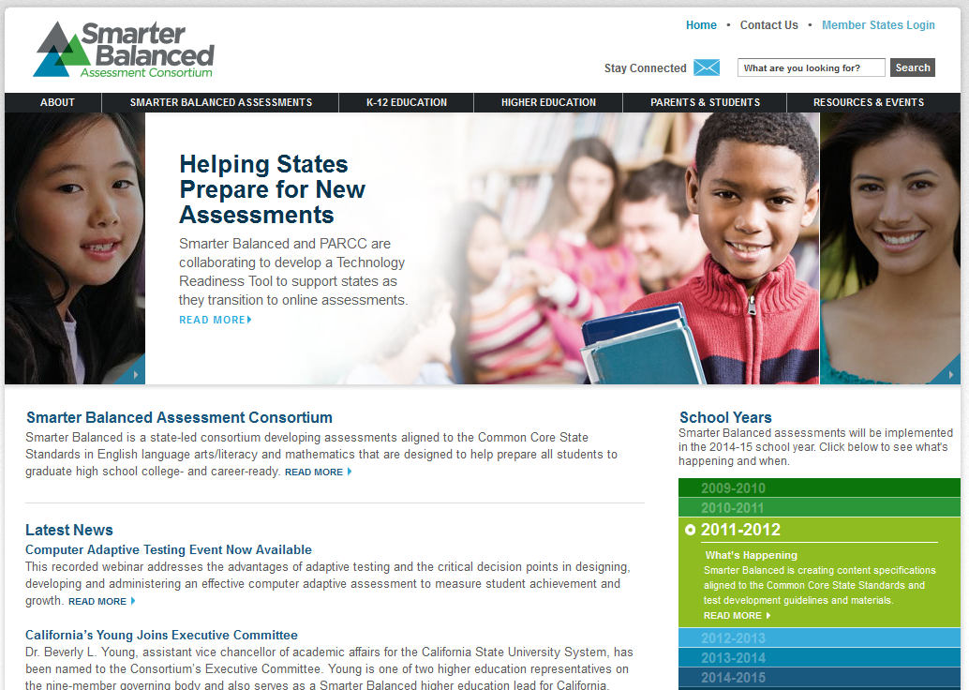
Find Out More
Visit Smarter Balanced online at SmarterBalanced.org
Sign up for an e-newsletter
Follow us on Twitter at @SmarterBalanced
Contact information for Dr. Dianne M. Bazell:
dbazell@qx.net
859.396.5293

