Slide 2
Training Agenda
Platform Overview
Teacher FAQs
Promotions

Slide 3
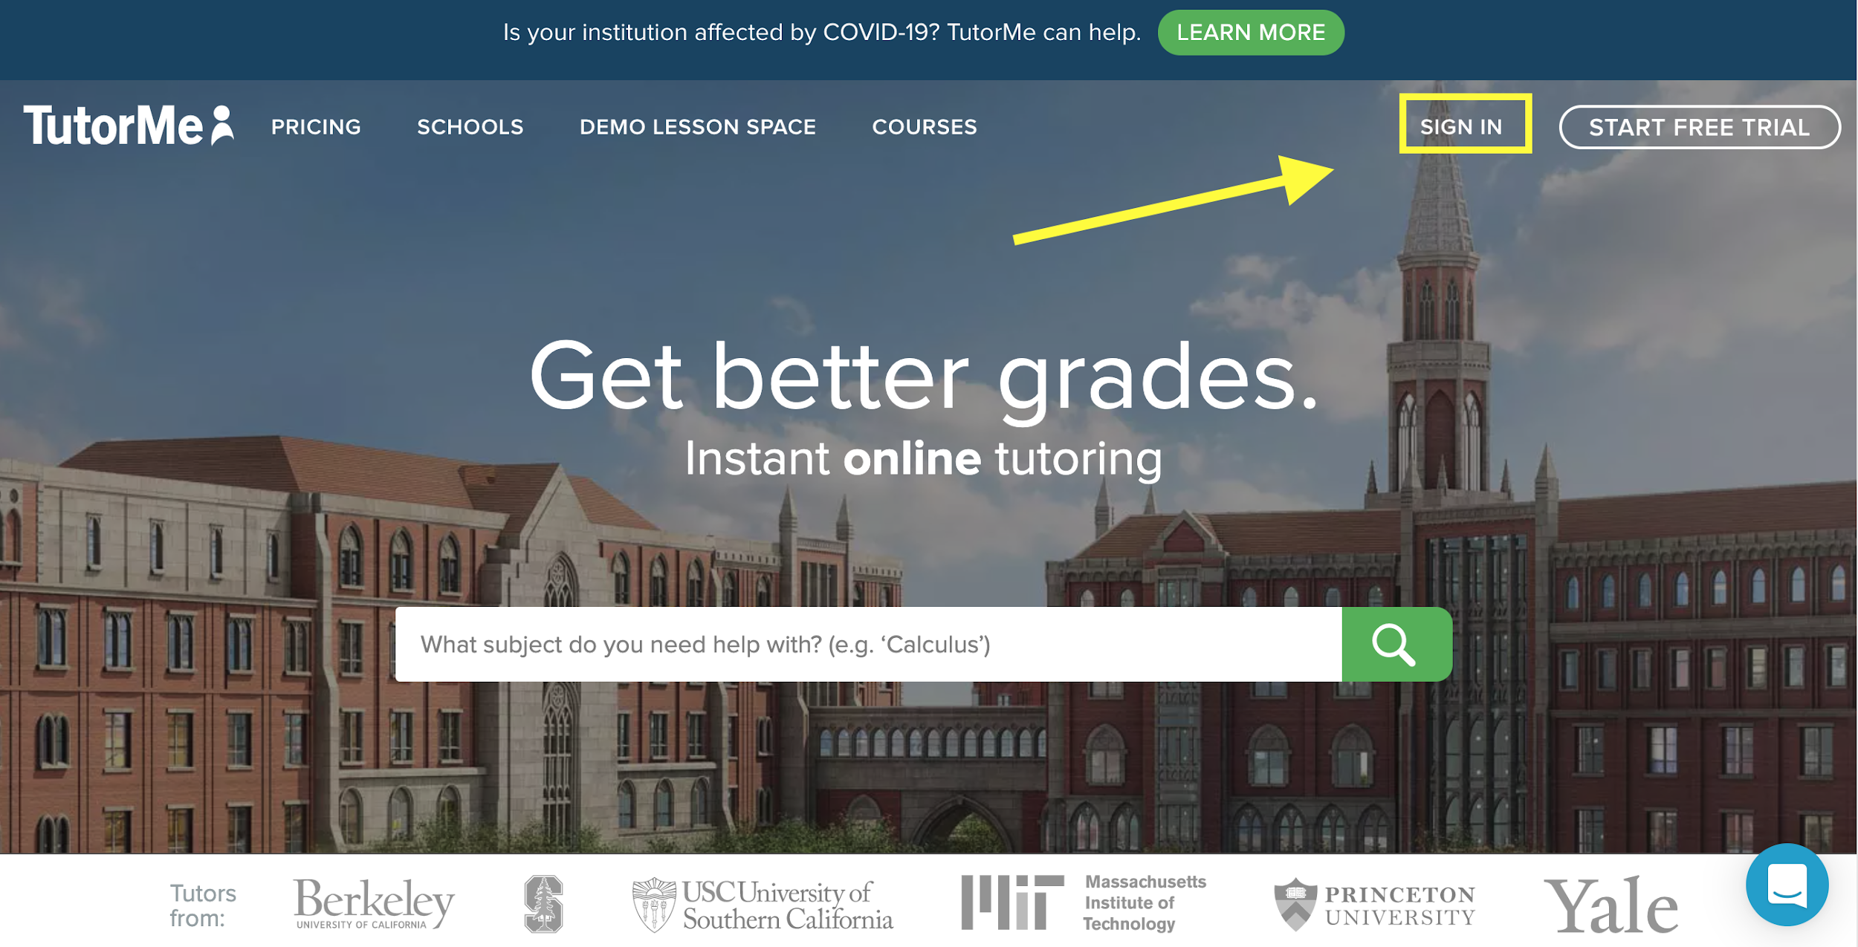
How to Connect with a Tutor
Step 1: Go to www.tutorme.com and click ‘Sign In’

Slide 4
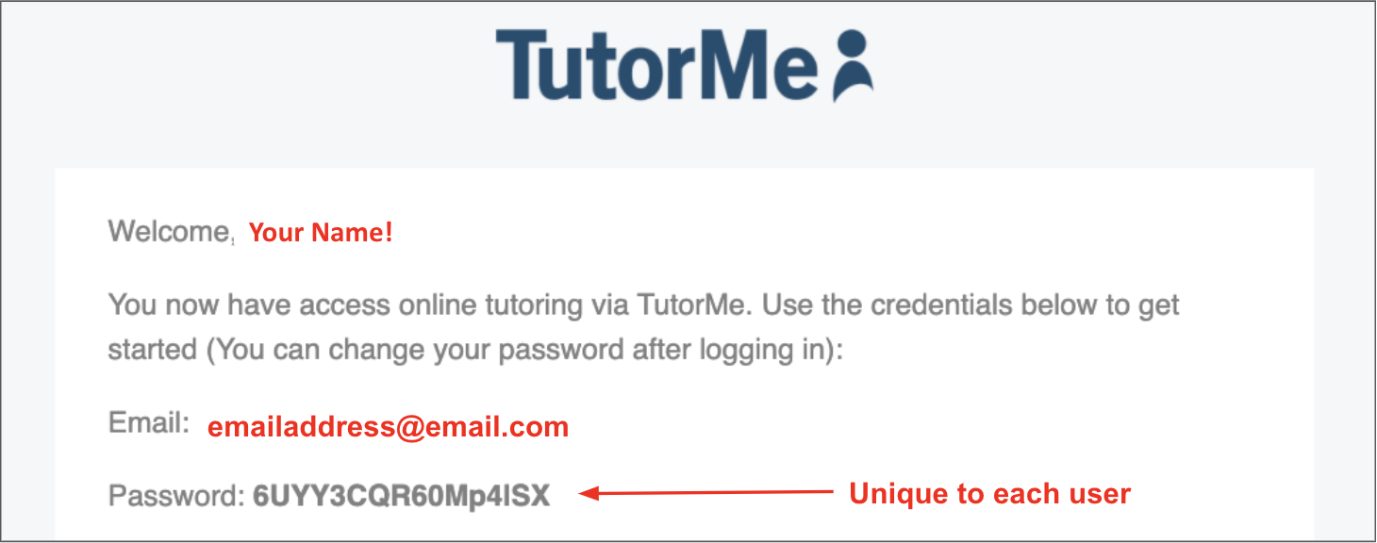
Students have received an email with their login credentials
Student’s Name

Slide 5
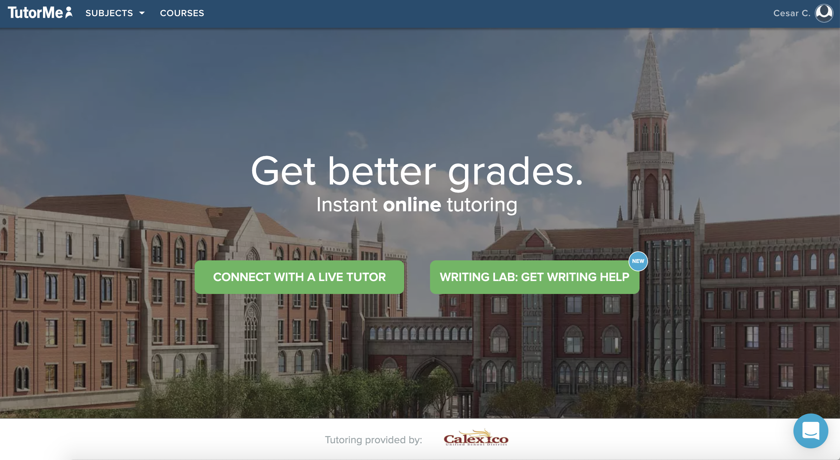
How to Connect with a Tutor
Step 2: Click on the Green Button
Notes:
CUSTOMIZE

Slide 6
How to Connect with a Tutor Step 3: Type a subject in the search bar
TutorMe supports over 300+ subjects!

Slide 7
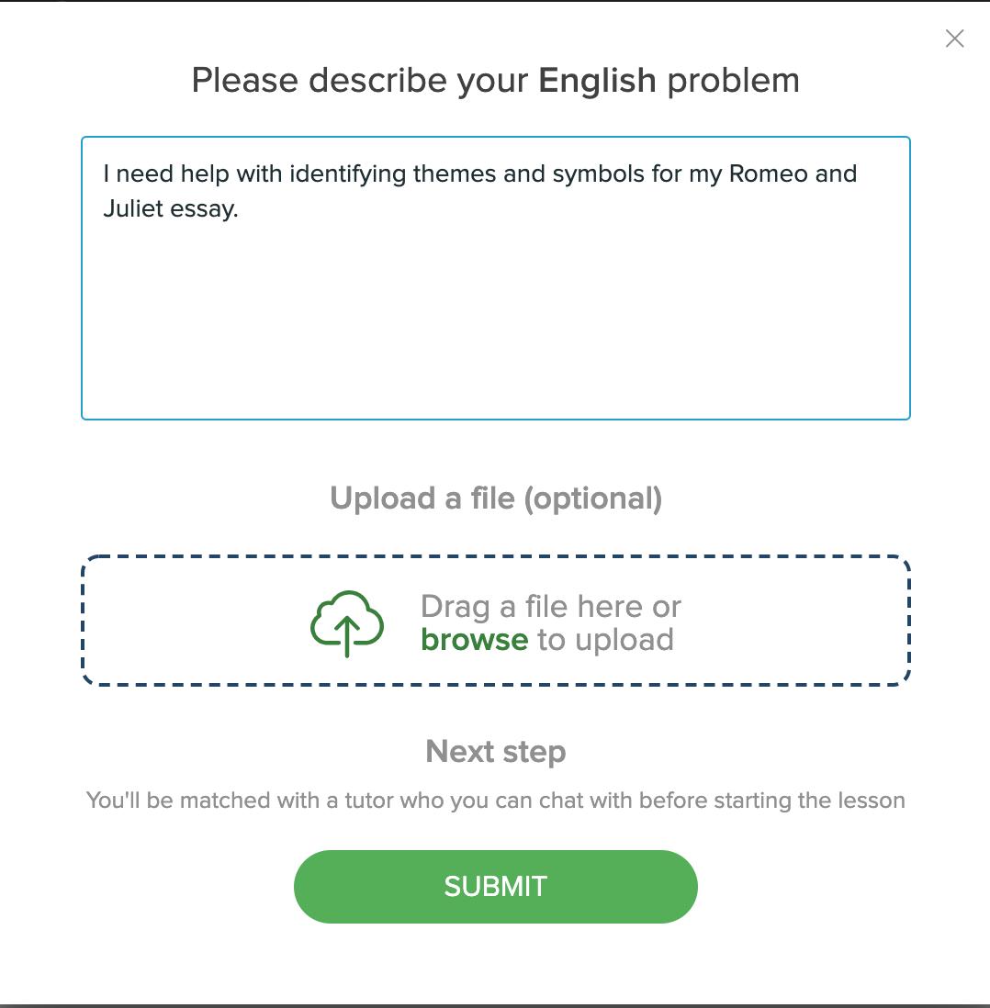
How to Connect with a Tutor
Step 4: Describe the assignment
Describe the assignment that you need help with. You can say, “I am a 6th grader and I need help with my math homework.”
Click ‘Submit’

Slide 8
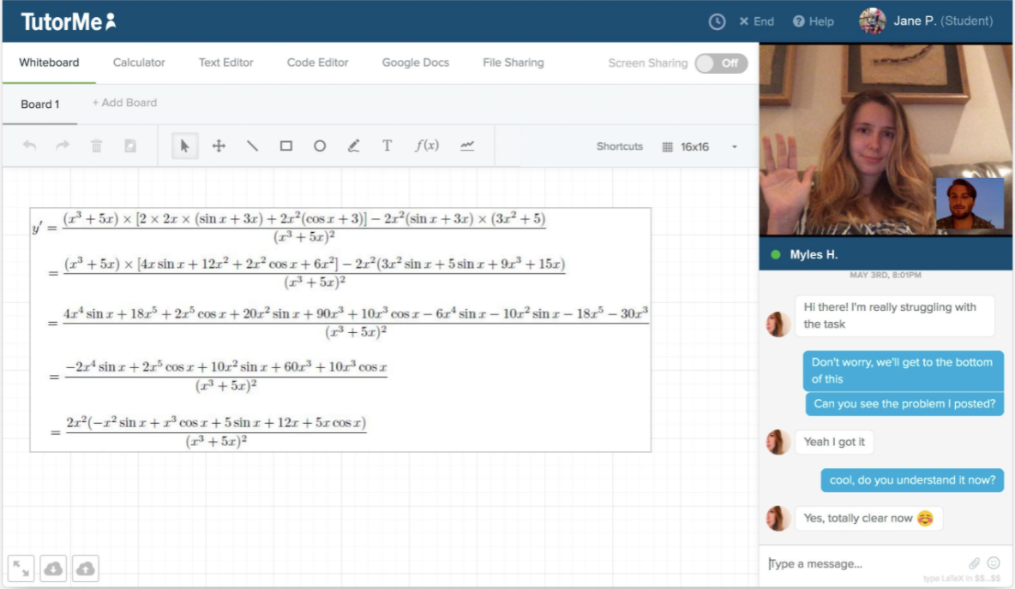
Lesson Space
Screenshare
Use audio/video!

Slide 9
The Feedback Loop
After every session, students and tutors rate one another, providing valuable feedback

Slide 10
TutorMe’s Writing Lab allows you to upload a paper and receive detailed feedback in less than 6 hours.

Slide 11
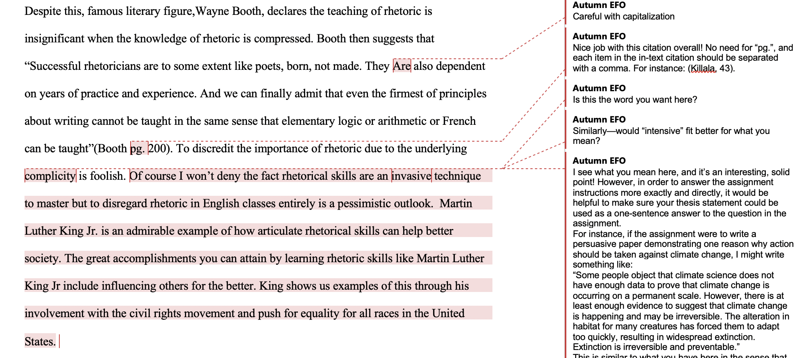
Receive your paper back in 6 hours or less!

Slide 12
Background checked
Verified
Consistently Reviewed for Quality

Slide 13
Teacher FAQs
What can students do on TutorMe?
Get help on homework assignment
Review past exams
Discuss lesson materials and videos shared by teacher
What if my students try to cheat?
All tutors are trained on how to teach the concept and process, not give answers
All lessons are recorded and viewable on the dashboard
Our Tutor Ops managers consistently review lessons to ensure

Slide 14
Teacher FAQs
What are my responsibilities? (Will it create more work for me?)
Promote the service so that your students and parents know about it!
When applicable, assign tutoring for struggling students
What if my parents or students have questions about TutorMe?
Have them contact our customer Support team!

Slide 15
Get the word out!
Parent Newsletter
Consistent Reminders
Embed in syllabus
Teacher/Counselor Referral

