Slide 1

Department of Recreation & Tourism Studies
College of Professional Studies
WVSU

Slide 2
Program Profile
Number of Headcount Majors (2015-2016)
  12
Number of Graduates (2015-2016)
  2
Number of Faculty
2 Full-Time

Slide 3
Curriculum
The curriculum consists of 43 credit hours of parks & recreation core courses, 6 credit hours of cognates, 35-37 credit hours of general education, and 16-21 hours of free electives.
Students must elect either an 18 hour specialization in Tourism Studies or a minor of choice (15-18 hours)
The curriculum prepares students for generalist practice in Parks, Recreation and Tourism.
There are currently no certificate programs specific to recreation and tourism.

Slide 4
Internship Opportunities
During their senior year, students complete 400 clock hours (6 credit hours) of supervised field experience at an approved professional site which plans, manages and / or performs parks, recreation and tourism deliverables.
An partial list of recent Internship sites includes:
Sites:
  Hatfield & McCoy Recreational Trails
  Coal River Group
  Kanawha County Parks
  Nursing Homes
  City of Spencer, WV; Department of Parks & Rec
  YMCA

Slide 5
Student Recognition
Alexander J. Keiffer was awarded the 2015 Cunningham Recreation Student Scholarship (WV Recreation & Parks Association) recognizing exemplary academic and leadership achievement from students pursuing professional careers in Parks, Recreation & Tourism.
Robert L. Bratton was awarded a WVSU Faculty Scholarship (2013).

Slide 6
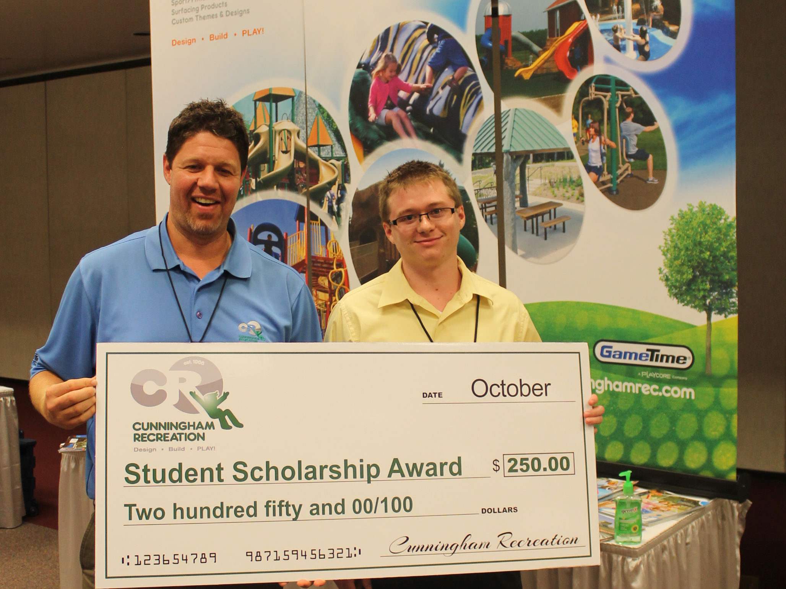
Student Scholarship – WV Rec & Parks Association
Alex Keiffer accepting the Cunningham Recreation Scholarship, an annual award recognizing one exceptional Parks, Recreation & Tourism student in the state of West Virginia for exemplary scholarship and leadership.

Slide 7
Articulation Agreements
A Memorandum of Understanding was signed with Boone Career and Technical Center (Boone County Schools) for an early enrollment program in Parks, Recreation & Tourism Studies.
The 1 + 3 program allows high school students in Boone County to get a jump start on their college education. This agreement allows students interested in pursuing careers in parks, recreation & tourism studies to earn college credit toward a Recreation & Tourism Studies major at WVSU.

Slide 8
Unique Highlights:
The Power of Collaboration
Collaborative relationships with WVSU Extension
  Tree Campus USA; campus arboretum
  Produce Pedalers; gardening and recreation programming for at-risk youth.
  Introduction to Gardening Seminar (Huntington Schools)
Putnam County Parks
- Nature Interpretation Project (Birding and Ornithology for Beginners)

Slide 9
Future Goals
Explore options for a minor in Parks & Recreation and a minor in Tourism Studies for those students with multi-disciplinary career ambitions in Business such a Tourism Management or Marketing; or in Science such as Natural Resource Management; or Natural Areas Management.
Continue to explore grant opportunities in the areas of sustainable development, natural resource management and ecotourism studies.
Explore 2+2 options with area community colleges; Early Enrollment options with local high schools; and expand online offerings, growing enrollment.

